Slide 1

Technology Fundamentals
Course Introduction
SoftUni Team
Technical Trainers
Software University
https://softuni.bg/

Slide 2
Table of Contents
Course Objectives
Training and Team
Course Organization
Course Infrastructure
Evaluation Criteria

Slide 3
Have a Question?
sli.do
#fund-java

Slide 4










SoftUni Diamond Partners

Slide 5



Educational Partners

Slide 6

Course Objectives

Slide 7
Java Fundamentals Objectives
Working with linear data structures
Arrays and Lists
Defining simple classes
Processing and manipulating strings
Regular Expressions
Building simple web project

Slide 8
Practical Programming Exam
Mid Exam
3 practical problems for 4 hours
Conditional Statements and Loops
Linear Data Structures – Arrays and Lists
Final Exam
3 practical problems for 4 hours
Strings and Text Processing
Associative Arrays
Regular Expressions

Slide 9
Theoretical Exam
You will have 30 minutes once you enter
Multiple choice with only 1 correct answer
English
Automated quiz system
Available online on the day of the practical exam
You can submit your answers just one time

Slide 10

The Team

Slide 11
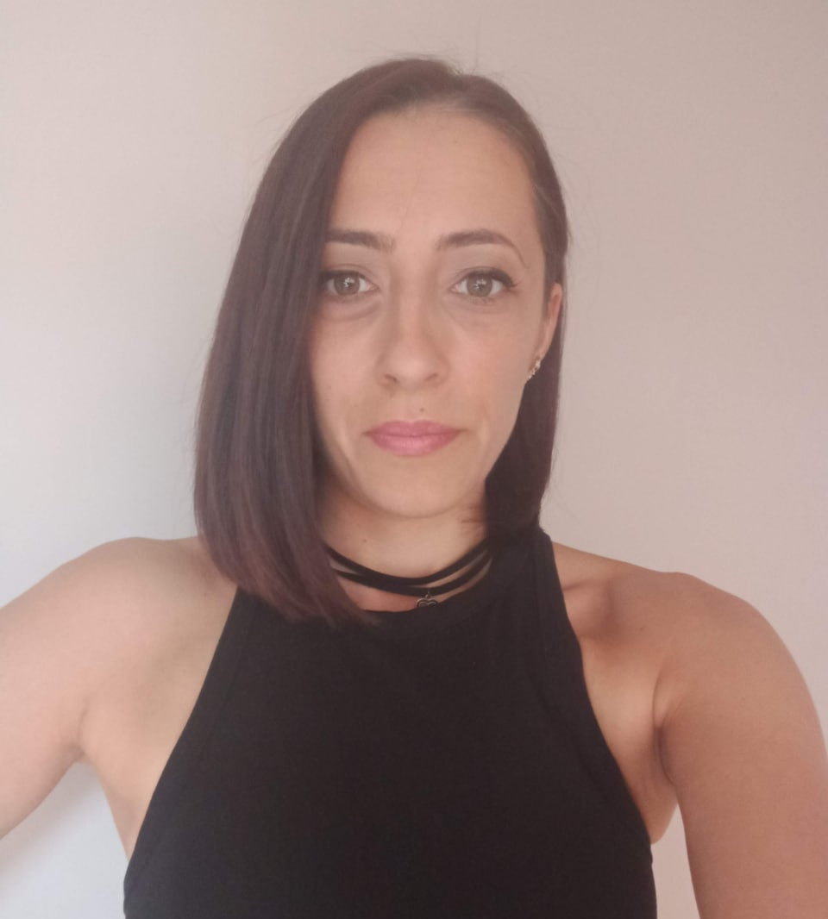
Veronika Vaneva
Graduated from the Medical University – Pleven
Technology trainer of many courses in programming, MS Office, Digital skills and others
Former Educational Director of SoftUni
Lecturer by vocation
Interests in workflow automation, as well as Java and C ++ technologies

Slide 12
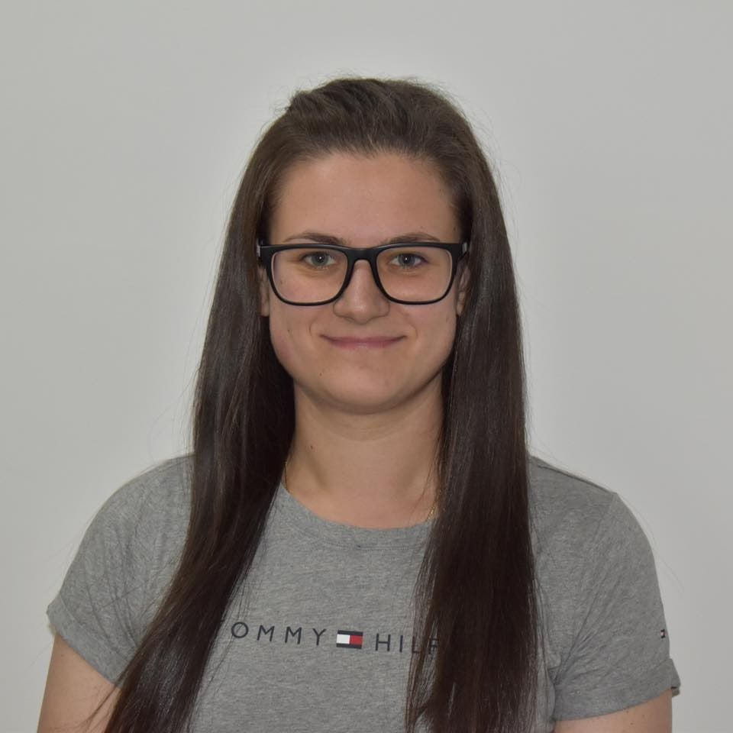
Desislava Topuzakova
Java Developer @ SAP
Ex-Competitor with Mathematics
Technical Trainer @ SoftUni
Programming Basics Team Lead
Content Development Team Lead @ SoftUni

Slide 13

Course Organization

Slide 14
Java Fundamentals Module
13-Sept-2021
24-Oct-2021
05-Dec-2021
09-Dec-2021
13-Dec-2021
Java Fundamentals
12 weeks * 3 times / week
12 credits
Start: 13-Sept-2021
Mid Exam: 24-Oct-2021
Theoretical exam: 05-Dec-2021
Final exam: 05-Dec-2021
Re-Take Exams
Mid Exam Retake: 09-Dec-2021
Theoretical Exam: 13-Dec-2021
Final Exam Retake: 13-Dec-2021

Slide 15
Course Scoring
Practice grade:
Theory grade:
SoftUni Certificate: 5.00 from Practice
CPE Certificate: 3.00 average from Practice + Theory
Practical Mid Exam
Practical Final Exam
Homework
40 %
60 %
+5 %
Theoretical Exam
100 %
15

Slide 16

Homework Assignments & Exercises
Your homework is mainly work in class
Lesson days → slides + live demos + exercises
Exercise days → only exercises
How to submit your homework?
Submitted in the judge system
Do your homework when it's due
Assignments pile up quickly

Slide 17



Java Advanced Course, Forum and FB Group
Official web site:
Official discussion forum:
Official Facebook group:
Community Facebook group:
https://softuni.bg/trainings/3448/programming-fundamentals-with-java-september-2021
softuni.bg/forum/categories/44/
https://www.facebook.com/groups/ProgrammingFundamentalswithJavaSeptember2021
https://www.facebook.com/groups/SoftUniJavaCommunity/

Slide 18
Questions?
Notes:
18

Slide 19
Trainings @ Software University (SoftUni)
Software University – High-Quality Education, Profession and Job for Software Developers
softuni.bg, about.softuni.bg
Software University Foundation
softuni.foundation
Software University @ Facebook
facebook.com/SoftwareUniversity
Software University Forums
forum.softuni.bg
Notes:
19

Slide 20

License
This course (slides, examples, demos, exercises, homework, documents, videos and other assets) is copyrighted content
Unauthorized copy, reproduction or use is illegal
© SoftUni – https://about.softuni.bg/
© Software University – https://softuni.bg
Notes:
20

